Slide 1

Sales Analysis

Slide 2
Business Description
Amazon (Amazon.com) is the world’s largest online retailer. Amazon offers its services all over the world. It operates its own websites in the UK, Germany, China, Australia, as well as many South American and Asian countries. Amazon.com serves 20 million customers every day. Its annual income is over 34 billion dollars. Amazon is a business empire that sells almost anything cheaper and faster than anyone else.
The main goal of the DWH is to analyse sales per different metrics.

Slide 3
Sources:
www.mockaroo.com;
www.kaggle.com/datasets;
Files from labwork 1.

Slide 4
Data Flow
Flat files
SA_SRC
BL_CL_1ST
BL_3NF
BL_CL_2ND
BL_DM
Flat files
Flat files

Slide 5
.csv files → SA_SRC
CREATE TABLE ext_delivery_methods
(
payment_method_name VARCHAR2 ( 200 CHAR ),
start_dt DATE,
end_dt DATE,
is_active VARCHAR2 ( 200 CHAR )
)
ORGANIZATION EXTERNAL
(TYPE oracle_loader DEFAULT DIRECTORY ext_sources
ACCESS PARAMETERS (fields terminated BY ',')
LOCATION ('delivery_methods.csv')
)
REJECT LIMIT UNLIMITED;

Slide 6
SA_SRC → BL_CL
TRUNCATE TABLE WRK_DELIVERY_METHODS;
INSERT INTO WRK_DELIVERY_METHODS
SELECT * FROM SA_SRC.EXT_DELIVERY_METHODS;
commit;
TRUNCATE TABLE CLS_DELIVERY_METHODS;
INSERT INTO cls_delivery_methods (
delivery_method_id,
delivery_method,
start_dt,
end_dt,
is_active
)
SELECT SUBSTR(delivery_method_name,1,4) AS delivery_method_id,
delivery_method_name AS delivery_method,
start_dt,
end_dt,
is_active
FROM wrk_delivery_methods;
COMMIT;

Slide 7
BL_CL → BL_3NF
TRUNCATE TABLE bl_3nf.ce_categories;
MERGE INTO bl_3nf.ce_categories t USING
( SELECT category_id,
category_name,
start_dt AS update_dt
FROM cls_categories
MINUS
SELECT category_srcid AS category_id,
category_name,
update_dt
FROM bl_3nf.ce_categories
) cat ON (c.category_name = t.category_name
AND c.category_id = t.category_srcid
)
WHEN MATCHED THEN
UPDATE SET
t.update_dt = SYSDATE
WHEN NOT matched THEN
INSERT
(
category_id,
category_srcid,
category_name,
update_dt
)
VALUES
(
bl_3nf.ce_categories_seq.NEXTVAL,
c.category_id,
c.category_name,
SYSDATE
) ;
COMMIT;

Slide 8
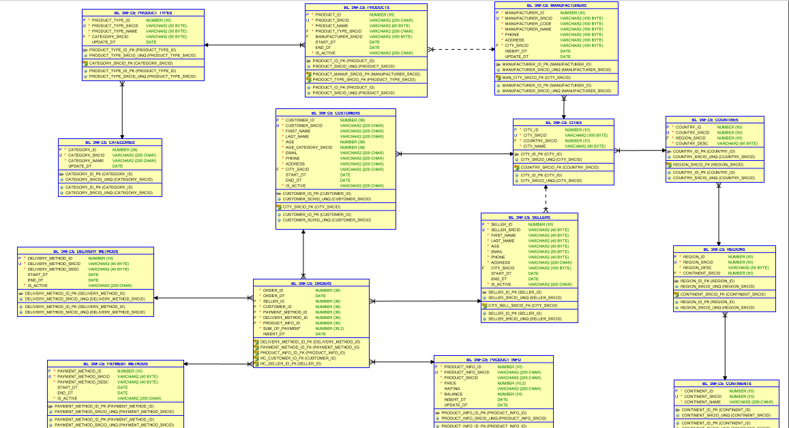

Slide 9
3NF
Ce_products
Ce_categories
Ce_product_type
Ce_manufacturers
Ce_customers
Ce_sellers
Ce_product_info
Ce_cities
Ce_countries
Ce_regions
Ce_countries
Ce_orders
Ce_delivery_methods
Ce_payment_methods

Slide 10
Dimenssions:
Dim_Products contains information about products, their manufacturers, and their stock availability.
Dim_Customers contains information about customers, their contacts and their locations.
Dim_Sellers contains information about company’s employees, their contacts and their locations.
Dim_Date contains date information.
Dim_PaymentMethod contains information about methods of payment of orders.
Dim_DeliveryMethod contains information about methods of delivering of orders.
Fact Table
The Grain: Each row in the table shows product that have been ordered by customer.

Slide 11
